Slide 1

Building a Regression Model in Tensorflow
Notes:
Hello, everyone. Welcome to this new hands on tutorial. In this tutorial we are going to be looking at how we can build a regression modeling TensorFlow, TensorFlow.
TensorFlow is one of the most popular deep learning libraries out there. And with TensorFlow 2.0, we have seen some good advancements, which makes it even more easier for us to build deep learning models, like adding off Kara's library, Kara's library makes it even more easier to build machine learning models. So in this deck, how you can build machine learning models, or in particular, how you can build regression models using neural networks in karass, using tensor flow, so thank you so much. Let's get started.

Slide 2
AGENDA OF THE VIDEO
An Overview of neural networks.
Types of layers in a neural networks.
Types of activation function in a neural networks.
Introduction to model building library called “Keras”.
Alternative to Keras.
Keras Model Building Procedure.
Make the architecture of Neural Network.
Compile the model with optimizers, loss function and metrics
Fit (Train) the Model
Predict on a new dataset
The dataset that we will be working with…
What is data scaling? Why is it required before building Neural Networks?
Pseudocode for Regression in Tensorflow with keras.
Task for you….
Notes:
So, in this slide I discuss about the agenda of this whole video.
So, i start with an overview of neural networks discuss about layers and activation functions in neural network discuss how these two important concept play a vital role in deciding of a successful neural network about these two important concepts I am going to discuss about a model building library called keras learning models and techniques the work really here to Pro provide by providing a sequential API about model model building procedure in keras it's actually a four step procedure about data scaling and how does data skating plays an important role in a neural network building we are going to be close this particular slide by do code for regression in tensorflow and then turning that pseudocode into actual python Hindi old video series and finally I am going to end the video by sharing some task

Slide 3
An Overview of neural networks
Neural Networks is a technique of modelling the interconnection of neurons in a human brain.
Building Neural Networks from scratch is a huge task. There are many concepts that needs to be taken care and still things can go wrong while coding the neural networks from scratch. Luckily for us, there are many people who are doing wonderful job by making neural network libraries and making it open source.
One such library is tensorflow which is one of most popular and powerful library for doing deep learning.
So, let us get started.
Notes:
So in this slide, what I'm going to do is I'm going to briefly talk about what neural networks is so neural networks, as the name represents is a network of neurons. And what do we mean by neurons neurons are something that exists in human brains. So, the network of these neurons is essentially what is known as neural networks. So what are we doing, what are we doing here, we, what we are trying to do is we are trying to kind of emulate the way our human brain makes this network automatically. We don't know how does this network work, but we want to try to somehow make this network in a computer simulation or something like that. So what we are trying to do is we are trying to make that kind of behavior in our computers. So, that is the whole idea behind artificial neural networks. Okay, so now, one more thing that building neural networks is really, really a difficult task. Obviously, it can happen, we can obviously build a neural network from scratch in Python, but the problem is that if we try to build that alone on ourselves, then what will happen is, one day or the other, we are going to run into trouble. And that is bound to happen, because there are just so many different parameters that we cannot simply think of all those parameters, if we have to simultaneously consider then human brain is not capable of constructing all those parameters. At one time, so. So building such a thing can get a little bit trickier. If we try to build it on your own. Obviously if you stretch it for some days and try to like get everything structured, then you can build it but then also it is better to just use it. Use some pre built libraries for a learning purpose, you can obviously build a neural network very simple neural network, but if you are trying to use that prebuilt Ted, your own built a neural network on your big projects, then that would not be a very sound idea. So, TensorFlow is one of the libraries which allow us to build deep learning models, really effectively and easily. And one more thing, Kara, is an epi, which is built on top of TensorFlow, which makes it even more easier to build, machine learning models and deep learning models.

Slide 4
Layers in a neural networks
First type of classification…
Input Layer = For regression, it would be a list of features.
Output Layer = For regression, it would be a single number as prediction.
Hidden Layers, can be any number of hidden layers, the more the number, the more complex patterns the network will be able to learn.
Another Classification of layers:
Dense, fully connected layers = Common to all types of tasks
Convolution layers = Common to Image and Video Related Tasks
Long short term memory (LSTM) layers = Common to Sequence data types (such as Time series, Stock data, Language data etc)
Notes:
Now let us talk about layers in neural networks. So layers can be understood using two different sets of definitions. The first set of definitions talks about layers in the form of input layer hidden layers
and output layers.
Now input layer you can think of as your features features, those you feed in your neural networks, hidden layer, you can think of
as layer, which does
some very magical computation and output layer you can think of as a layer, which produces your output. So, this is a kind of classification no hidden layer you can have as many as you want. According to the problem and according to the way you want your accuracy to be. Okay, now we have got one more classification of layers, and that classification of layers is depending upon the task that we are solving at head. We can have an image classification task for those type of tasks, we need to use a different type of layers, known as cnn convolution layers. Okay, hence the name convolutional neural networks, and they are used, especially for the purpose of image prediction. And we have also got one more type of layers of neural networks which are known as long short term memory layers and those layers are essentially used for sequence data. The data set like time series data, or the data set like language data which are having some inherent sequence pattern in it. So those type of data for those type of data we will be using.
layers are essentially used for sequence data. The data set like time series data, or the data set like language data which are having some inherent sequence pattern in it. So those type of data for those type of data we will be using lsdm layers, but you don't need to be worried about these two types of layers in this video. In this video, you just need to understand about density is now dense layers or layers which are densely connected. So what do we mean by dense layers. Now, suppose earlier, which is having four neurons and suppose, another layer which is a, which is previous to this particular layer which is having eight years, eight neurons. Now, eight neurons and four neurons they are densely connected, what do we mean by that, we mean that each neuron in each layer will be connected to each other. So that is what we mean by.

Slide 5
Activations Functions
Activations functions are what allow us to take the data of one layers and transfer it to the next layers.
Further, these functions are what allow the network to behave somewhat (not exactly) like human brain.
Human brain has billions of neurons. All these neurons work in a cohesiveness to by transferring and receiving data from other neurons.
Which neurons will take part in one decision making? How is this decided?
If a certain neurons fires, then it will take part in the decision while if doesn’t, then it won’t. IT WAS A VERY HIGH LEVEL OVERVIEW OF NEURONS.
Notes:
Now let us talk about activation functions in this slide. Now what do we mean by activation functions, no activation functions are what allow us to transfer data from one layer to another. Now, suppose we have an input layer, how can we transfer that input layer to the hidden layer. So that hidden layer can transfer it back to the output layer. So the way it is going to work is as follows. We have a. We have a concept of activation functions. And what activation functions, allow us to do is, we can using the activation functions, take the input and multiply it with a vector called weights weights, is what we learned from the neural network while training, and we pass that multiplication. Through this activation function, and we get as a result some number, and those numbers will be passed into the hidden layers into the further layers. Okay, so this is the whole idea. And you can also think of hidden layer activation functions as something which emulates the kind of behavior that all our neurons in our brain works in our brain. We have a notion of whether a particular neuron is firing or not firing. Now, that behavior. We can also capture, using this activation function, we can have our activation function light, if the input is greater than zero, then the neuron will fire. Whereas, in other situations, it will not fire, so these type of neurons.
These type of activation functions might emulate the behavior of firing or not firing. Okay, so it is a very high level overview of neurons and activation functions. Do not take them. literally, but try to understand the idea behind it.

Slide 6
Intro to Model Building Library Called Keras
Keras is one of the API which is provided when you install tensorflow and it a very high level wrapper and makes really easy to build neural networks of any kind:
Perceptrons
Simple Neural Networks with as many hidden layers
CNNs
RNNs
LSTM + RNNs
Etc
Adding layers in a model is as easy as adding two numbers in Keras.
Notes:
Okay so with this particular slide, I want to introduce you all with the library called Kairos not care us is a very high level API, which is included in TensorFlow 2.0. And the reason for its inclusion in the tensor flow was that it was one of the most powerful library for building machine learning models but nowadays we also have like libraries like pi torch and piano. And there are other libraries like CNT k also, but can you still care us is really popular and really useful for Los Altos sorts of tasks, and it can build neural networks for any guide like perceptron simple neural network with as many as hidden layers and the level of ease of use, is really huge.

Slide 7
Model Building in Keras
Make the model architecture using the various combination of layers
Sequential API
Functional API
Compile the Model once the architecture is ready. This step is needed for telling the model about the type of optimizer, loss and metric.
Train the model using the architecture and wait until it runs.
Once the training process is completed, use your model to make predictions.
Notes:
So on this slide, I want to talk about four step model building procedure in Cara's.
0:11
The reason that I say this four step model building procedure in Cara's is that no matter what model are you fitting, no matter what data set, are you working with no matter what kind of architecture you are working with you can be working with CNN RNN these four steps will always be there. So the first step is to choose which API Are you going to use. There are two sorts of different API's that Kara's provides functional API and sequential API. There are many people who are still using functional API for all sorts of reasons, but I feel sequential API will give you the ease of use and flexibility to build your deep learning models, really easily. In a flexible way and in in a quick way.
1:00
And once you have decided that, which API Are you going to use, then the next step is to add your layers to it, since we have already talked about dense layers, and we are we are only going to be talking about dense layers, and how to add dense layers to this API in the coding sections also. After you have defined your models architecture. Throughout the next step would be to start compiling your model. So what do we mean by compiled ation of our model in the compilation step, what we are essentially trying to do is we are trying to set up few configurations that are required while training the model, like, what is the loss, what kind of optimizer, and what kind of matrix that our model will be evaluated on. So these are all sorts of things. We'll be decided. At the time of optimal compile ation.
1:51
And once the first two steps has been done, almost all the work has been completed, and you just need to train your model using the data set provided. Now notice here that you need to wait for some time while the model is running. because not always you will be getting the results very quickly because if your data set is huge. If you have provided number of hidden layers and number of neurons in each hidden layer, very large, then in that situation, your model is probably going to take forever to learn. I mean, sometimes it has been seen that with the model takes even one day to day like like sometimes it takes 10s of days to train a particular architecture. Okay. And once that model has been trained, you can successfully Enjoy your model.

Slide 8
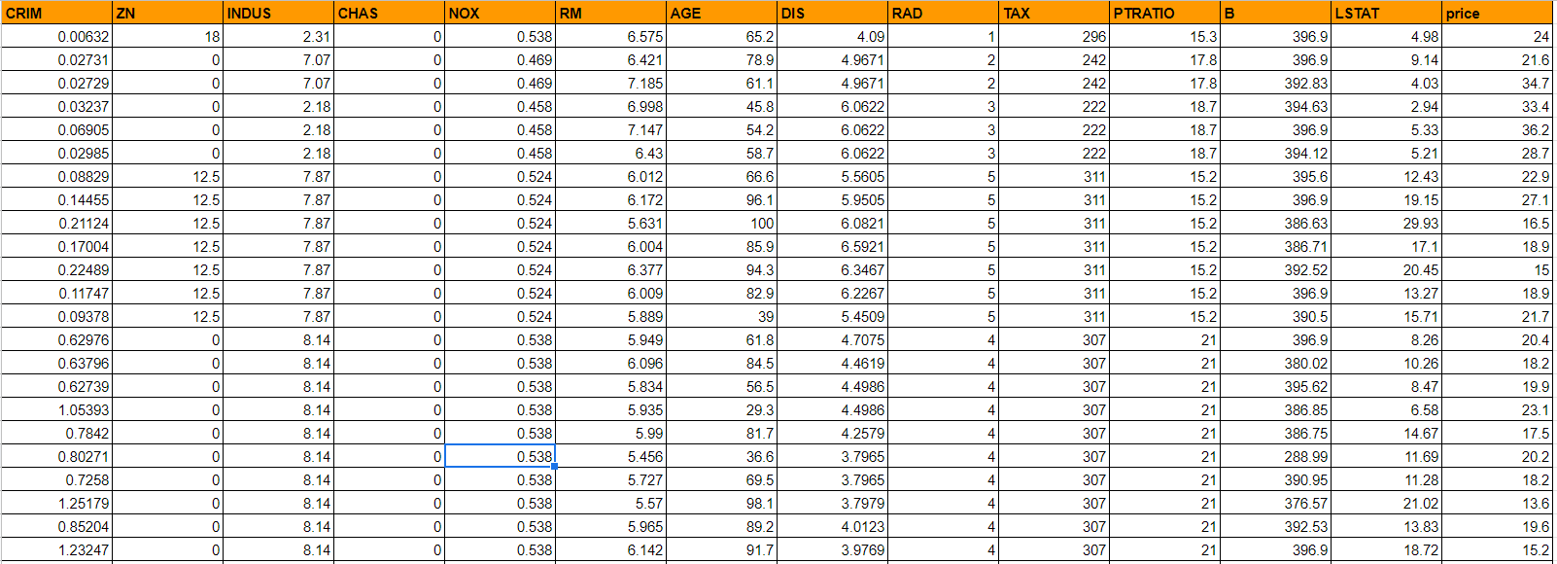
Dataset
Notes:
Here, I have just displayed the boston housing data that we are going to be working with in this video.
We have got a variable to predict which is price and we have got several features like “CRIM”, “ZN” etc.
Using these features, we can predict the price using neural networks that we are going to build.

Slide 9
Data Scaling
Data Scaling is one of the many steps that we follow before actually modelling our data.
It becomes even more important when we have to train a really huge neural network.
First what is data scaling?
Data scaling is a procedure which is followed to bring our data ranges in a permissible range. Say, I have a variable income. Some people might be quite rich having income close to 1 billion dollars while some might just have in 10000 dollars. In this situation, what we do is we perform the step of data scaling to bring our data in some low data ranges.
The reason data scaling is important is because in optimization problems when the model is trying to figure the best values of weights, very large values can distort the model. It might make the model overshoot the optimum values or just make the model learn weights really slow.
Notes:
Now let us talk about one of the most important concepts in not only neural networks or deep learning, but in all of the machine learning, and it becomes even more important in deep learning, and the concept is data scaling. See, data scaling is a concept or other term used to bring your data in the same ranges. Now consider an example where I am taking.
And also I have given the example on the slide itself, that if I'm having a variable of people people's income, then some people might be having incomes are very huge, but some people might be having income, in a very less denomination like for example $10,000, or some, someone might have $1 billion. Now if I try to fit a machine learning model using this set of data. Now, it will correctly work on that data as well but the way it is going to run and the time it is going to take to run is going to be quite long. To avoid two situations, what we do is we scale this data, and we bring all the data points into the same ranges, like zero to one or zero to three or whatever, but that has to be small. Okay. And in neural networks and deep learning since the, the number of neurons are huge number of hidden layers are huge and the number of weights that we are trying to learn is also huge. So in those situations. Since each second is very crucial in both situations data scaling becomes even more apparent and important. So that is why I have discussed this thing in this particular slides. And in this particular video.

Slide 10
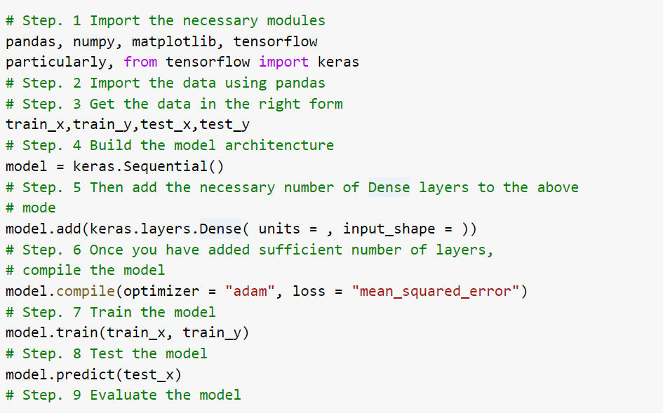
Pseudocode
Notes:
So, here I have discused a pseudo code that we are going to follow to make the neural network model to predict the price.
Try to read all the steos very carefully. Each step should be very clear and these steps we are going to refer back to once we are coding the REGRESSION in keras.

Slide 11
Task for you..
We have just successfully fitted a multilayered neural network model on our boston price prediction data. Now, your task would be to execute the following:
Experiment with adding as many number of hidden layers as you want to add. Compare the results you get and compare the time it takes to get those results.
Experiment with adding more neurons to each hidden layers. See, whether it improves or makes your model poor.
Change the number of epochs. How does that affect the training time and accuracy?
Also, try to play with batch_size and see if it has any impact on time and performance.
Finally, make a neural network on your own data, any data. Just make it run.
Notes:
Okay, Now that we have successfully understood how can we build a NEURAL Network in tensorflow and use for our regression tasks, and we also know how can we tweak various parameters to get a best model by doing some hit and trial method. With this, we have now come to the end of the video where I have some task for you. In particular, I have some five tasks for you. All of these tasks, revolve around changing the parameters of the Sequential API and try out bunch of values and see how does each values relate to each other.
Task. 1 Experiment with adding as many number of hidden layers as you want to add. Compare the results you get and compare the time it takes to get those results.
Taks. 2 Experiment with adding more neurons to each hidden layers. See, whether it improves or makes your model poor.
Task - 3 Change the number of epochs. How does that affect the training time and accuracy?
Taks - 4 Also, try to play with batch_size and see if it has any impact on time and performance.
Taks -5 Finally, make a neural network on your own data, any data. Just make it run.
I hope you will attempt these tasks.
Thank you

Slide 12
Thank you

